Slide 1
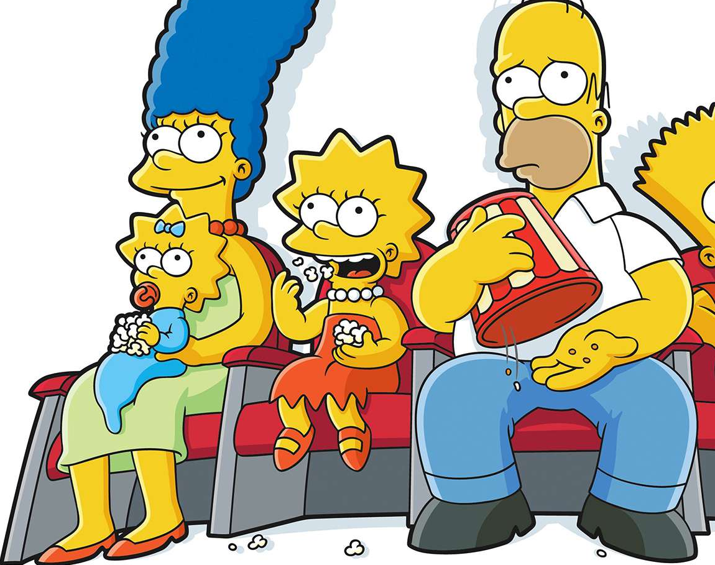

Simpsons’ classification
Project by: Heba Maher
Norhan Ayman
Heba Adel

Slide 2


1.project
*Project is a supervised classification problem, carried out using CNN.
*The final accuracy is 97% in training, and 95% in testing.
Code on kaggle
(Simpsons_classification (kaggle.com))

Slide 3

2.Dataset
Link
(The Simpsons Characters Data (kaggle.com))

Slide 4
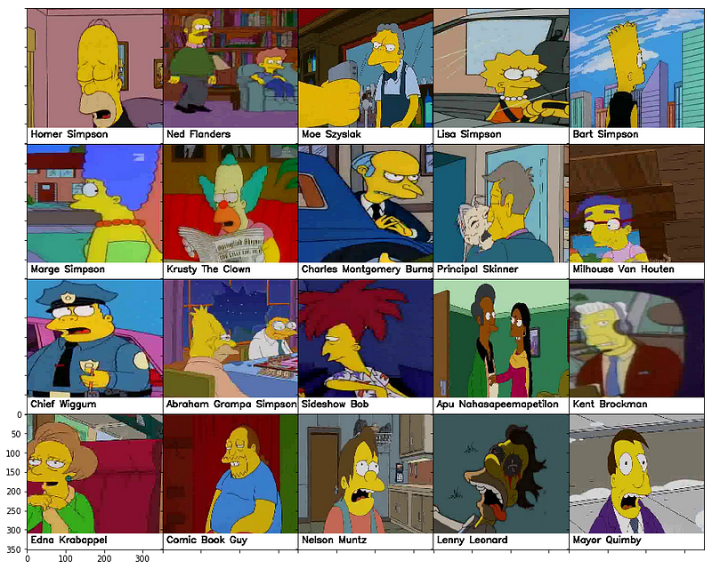
About Dataset
This is an image dataset: 42 folders (one for each character) with 400-2000 pictures in each folder.
Data is directly taken and labeled from TV show episodes.
File simpsons_dataset_test : separate images for testing.
ALL images uses jpg format, colored and of different sizes

Slide 5
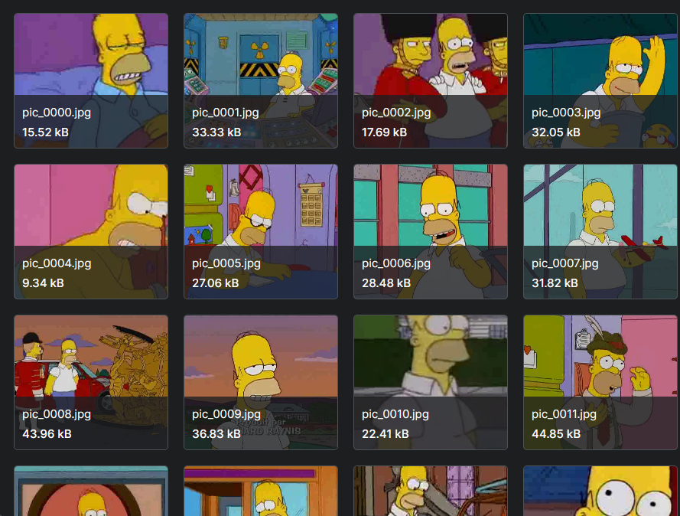
Example from the dataset

Slide 6
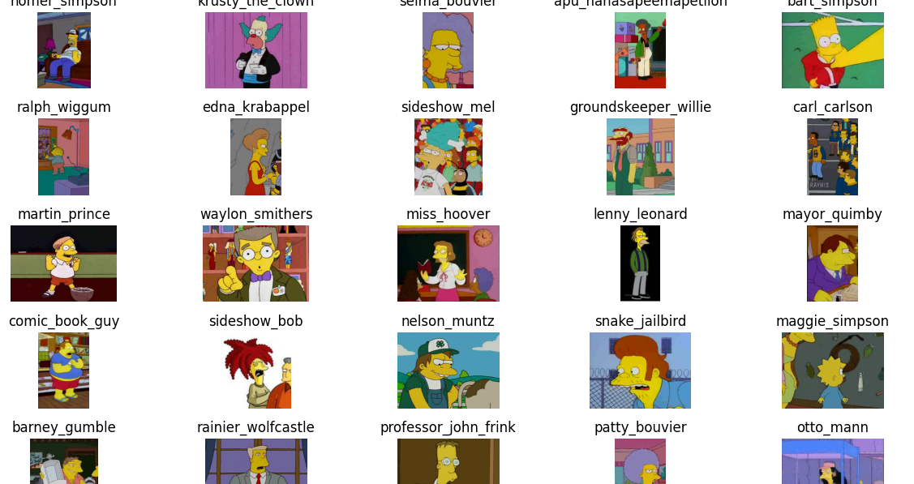

Slide 7
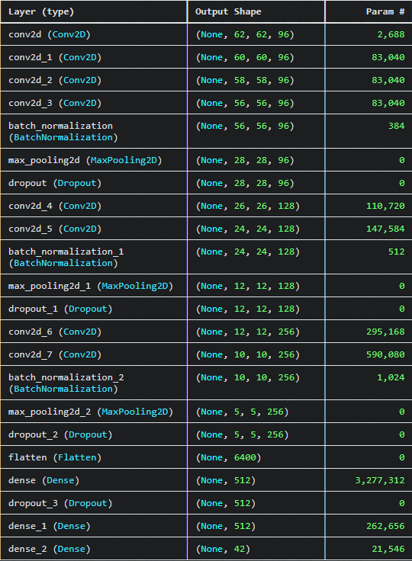
Model description

Slide 8
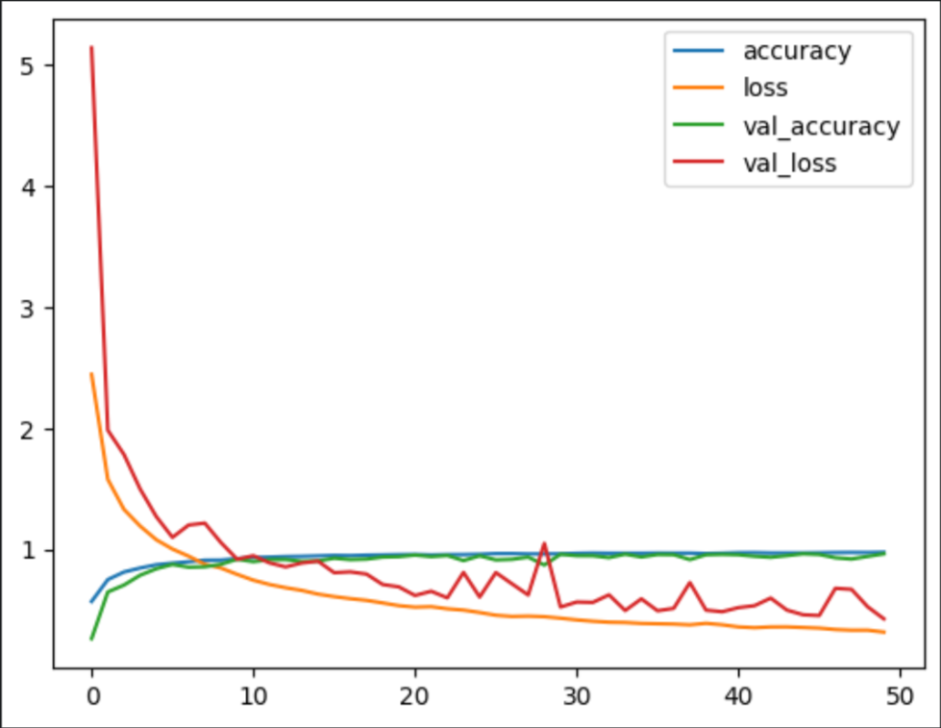
history of the model training
epochs

Slide 9
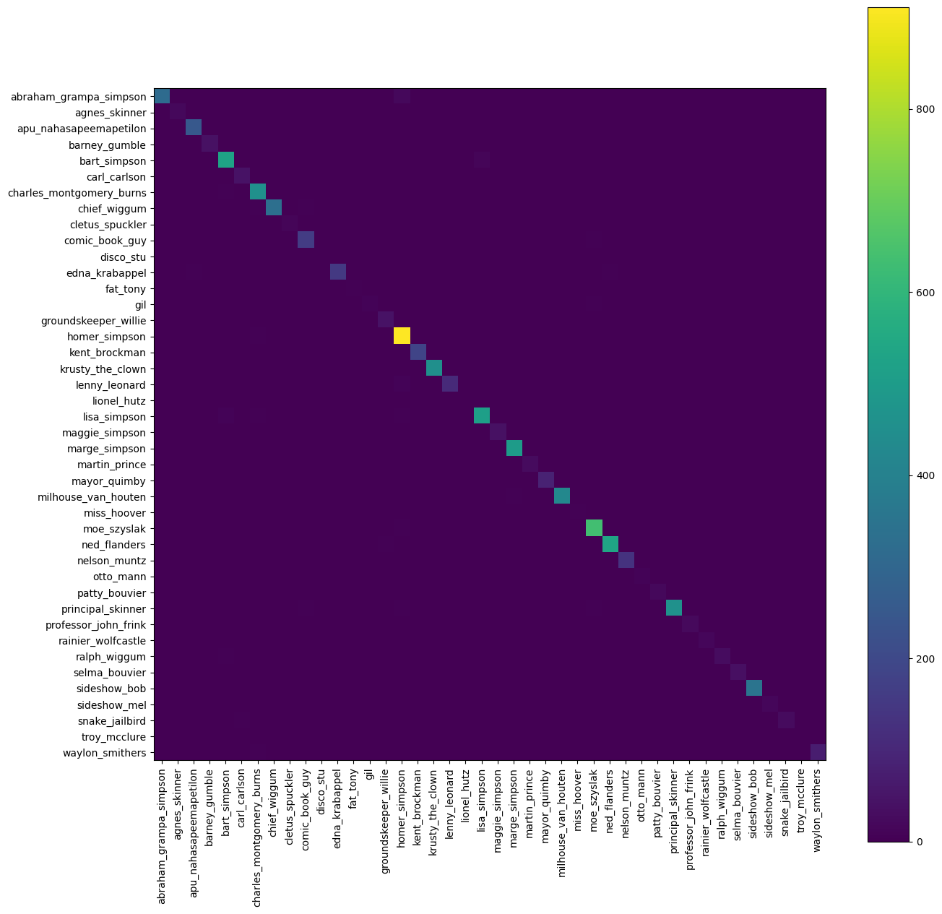
Confusion matrix

Slide 10
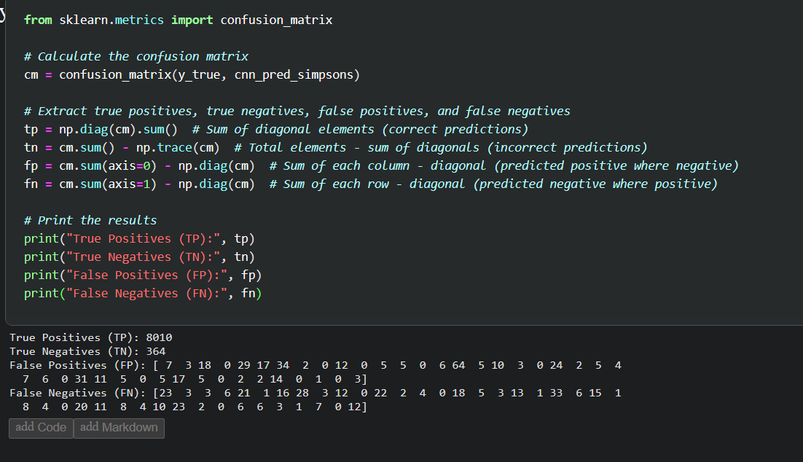

Slide 11
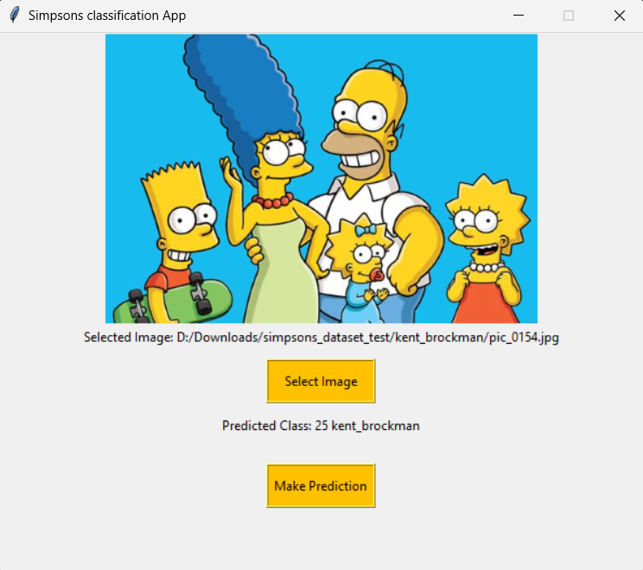
gui

Slide 12




Thank you

